Slide 1
Avoiding Violent Behaviors & Resources for Help
8.ICR.1.2

Slide 2
Conflicts haven’t really changed. The problem is that now people solve them in a different way.
Do you agree or disagree with this statement?
Do you think your parents would agree or disagree? Grandparents?
If you agree, what has changed regarding the likelihood of people handling conflict in violent ways?

Slide 3
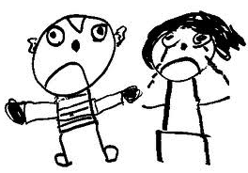
Violent Behavior: acting with or characterized by great physical force, so as to injure, damage, or destroy.

Slide 4
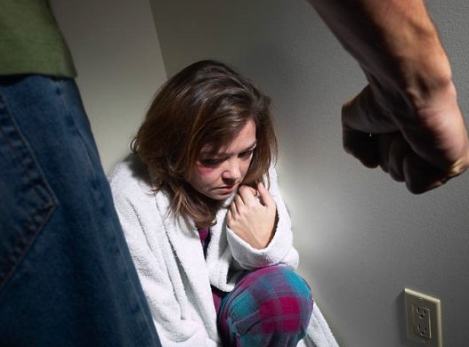
What are examples of violent behaviors?
Bullying
Hazing
Dating violence
Sexual assault
Family violence
Verbal abuse

Slide 5
What are some examples of violent behavior?

Slide 6
What Causes Someone to Punch, Kick, or Use a Weapon Against Someone Else?
http://www.wordle.net/

Slide 7
Possible Causes for Violence Include:
Genetic predispositions
Social problems, such as poverty, discrimination, child abuse, lack of family values, drug and alcohol addictions
Cultural factors – e.g. violence portrayed in the media

Slide 8
Media Influence
Video game units are now present in 83% of homes with children
94% of games rated (by the video game industry) as appropriate for teens are described as containing violence, and ratings by independent researchers suggest that the real percentage may be even higher
Source: Huesmann, L.R. & Taylor, L.D. (2006). The role of media violence in violent behavior. Annual Review of Public Health. 27 (1)

Slide 9
Video games depicting violence require the player to identify with the aggressor and interact with other characters through aggression and violent behavior.

Slide 10
Violence in Music Lyrics
Evidence suggests songs with violent lyrics increase aggression-related thoughts and emotions.
Repeated exposure to violent lyrics may contribute to the development of an aggressive personality and could indirectly create a more hostile social environment.
Source: Anderson CA, Carnagey NL, Eubanks J. Exposure to violent media: The effects of songs with violent lyrics on aggressive thoughts and feelings. Journal of Personality and Social Psychology. 2003; 84(5):960.

Slide 11
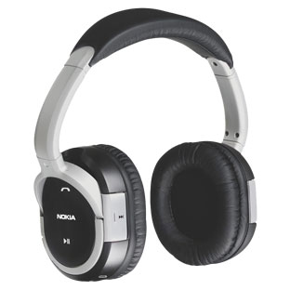
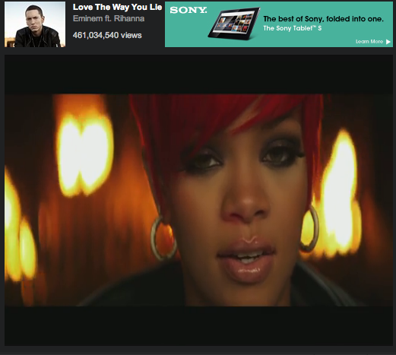
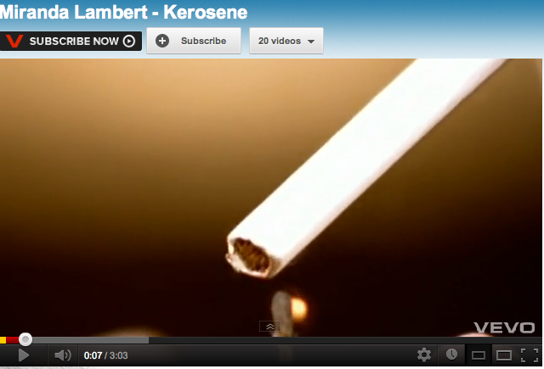
Violence in Music

Slide 12
Violence on Television

Slide 13
Causes of Violence
It is difficult to determine strongest predictor and exclusive cause of violent behavior; however, like all learned behavior – it can be CHANGED.

Slide 14
Factors Which Contribute to Violent Behavior:
Peer pressure
Need for attention or respect
Early childhood abuse or neglect
Witnessing violence at home, in the community, or in the media
Easy access to weapons

Slide 15
Immediate Warning Signs of Violence
Pattern of anger or loss of temper
Frequent physical aggression
Significant vandalism or property damage
Increased use of drugs or alcohol
Detailed plans to commit acts of violence
Announcing threats or plans for hurting others
Carrying a weapon

Slide 16
Potential for Violence Exists, If You Observe the Following Signs Over Time
History of violent or aggressive behavior
Serious drug or alcohol use
Gang membership or strong desire to affiliate with a gang
Access to or fascination with weapons
Threatening others regularly
Trouble controlling feelings
Withdrawal from friends and usual activities
Experiencing rejection and isolation
Having been the victim of bullying
Feeling constantly disrespected
Failing to acknowledge the feelings or rights of others

Slide 17
How to Respond
Don’t spend time alone with people who show warning signs for violent behavior.
Tell someone you trust and respect about your concerns (family member, teacher, counselor, police officer).
Report any threats (electronic, verbal, or physical confrontation).

Slide 18
Resources for Help
9-1-1 for emergencies
School counselors
School administrators
Teachers
School Resource Officers
Coaches
Faith leaders
Local police department
Local domestic violence shelter

