Slide 1
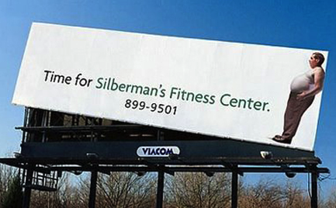
Advertising: It’s Everywhere!

Slide 2
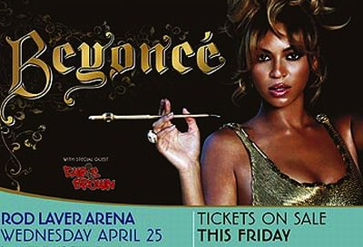
Advertising can influence unhealthy choices . . .

Slide 3
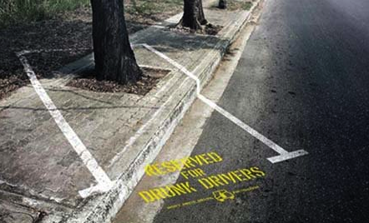
Advertising can influence healthier choices . . .

Slide 4
Advertisements are . . .
clever
silly
creative
intrusive
persuasive
hilarious
LOUD!
imaginative
thought-provoking
entertaining
distracting
annoying
powerful

Slide 5
Where do you see or hear advertisements?
Billboards
Magazines
Newspapers
Internet
Radio
Music
Sports
Posters
Television
Movies
Clothing
Bumper stickers
On taxis, buses
Infomercials

Slide 6
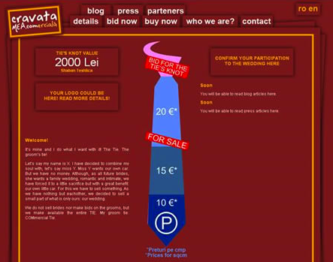
But, mostly, . . .
Recently, a groom sold space on
the tie he wore for his wedding.
they are EVERYWHERE!

Slide 7
“People believe what they see. If what they’re seeing is seducing them into a deadly addiction, then we need to counter the seduction by reversing what they see. In other words, fight fire with fire!” BADvertising Institute

Slide 8
Counter Ad Example

