Slide 1
Influences of Media, Culture, and Family Values on Becoming or Remaining Abstinent

Slide 2
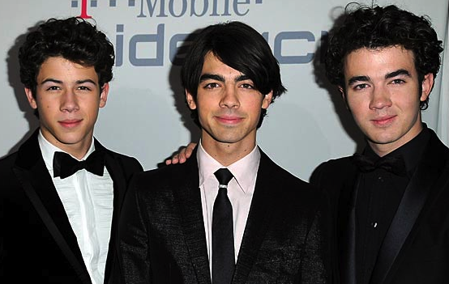
Is the media responsible for mixed messages that may be confusing?
Pledges of abstinence by celebrities: How effective are they in influencing others?

Slide 3
Is culture an influence on abstinence decisions?
Does a strong religious message help youth delay intimate behavior?

Slide 4
How important are families in influencing our choice to become or remain abstinent?
Most teens want their parents to share their expectations.

