Slide 1
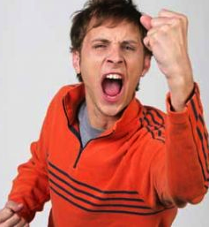
Anger Management

Slide 2
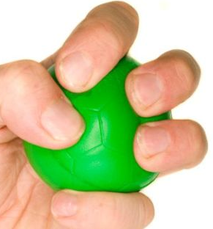
Reducing Our Anger
Walk away
Count to ten
Take deep breaths
Exercise
Write in a journal

Slide 3
Reducing Our Anger (continued)
Talk to someone
Listen to music
Write a letter to the person who made you angry and then tear it up

Slide 4
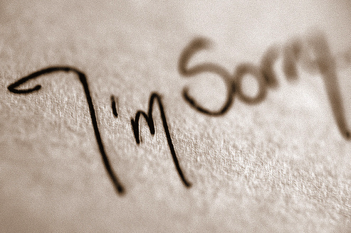
Ways to Defuse Our Anger
Suggest that you discuss the situation later when both parties have calmed down
Admit when you are wrong and apologize
Listen to the other person’s point of view

Slide 5
Ways to Defuse Our Anger (continued)
Use a calm voice
Try to agree on a point
Get advice from an adult

