Slide 1
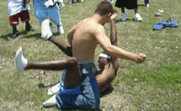
Types of Consequences of Violence

Slide 2
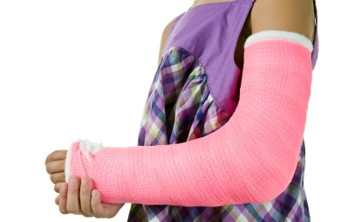
Physical Consequences
This type of consequence involves harm to the physical body. (Examples: a black eye, a broken bone)

Slide 3
Legal Consequences
This type of consequence occurs when the action of an individual is against the law. (Examples: being charged with criminal harassment or felony battery)

Slide 4
Emotional or Mental Consequences
This type of consequence affects how the person feels about himself or herself. (Example: Person feels embarrassed or ashamed of his or her behavior.)

Slide 5
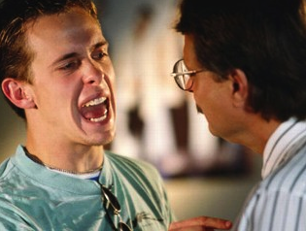
Social Consequences
This type of consequence affects an individual’s relationships with his or her family, friends, or other important people. (Example: Your parents do not like your friends if they are involved in violent acts.)

Slide 6
Academic Consequences
This type of consequence has an effect on an individual’s school performance. (Example: Suspension for fighting affecting a student’s grade.)

Slide 7
Financial Consequences
This type of consequence results in some sort of expense. (Example: The behavior costs money, such as a fine or court costs.)

