Slide 1
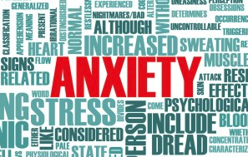
Coping with Anxiety

Slide 2
Two Sides of Anxiety
Anxiety itself is neither helpful nor hurtful. It’s your response to anxiety that is helpful or hurtful.
Sally Winston, Anxiety & Stress Disorders Institute

Slide 3
Two Sides of Anxiety
Before I go on, I’m a nervous wreck. But I feel more comfortable being uncomfortable.
Richard Lewis, Comedian

Slide 4
Two Sides of Anxiety
In the right amounts, the hormones that drive anxiety can be powerful stimulants, arousing the senses to function at their sharpest.
Alice Park, Time Magazine

Slide 5
How Anxiety Affects the Body and Brain
Immune system?
Breathing?
Cognition?
Digestion?
Emotion?
Skin?
Heart?
Metbolism?
Pain?

Slide 6
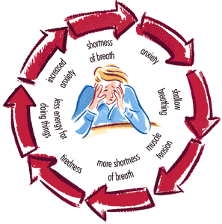
Definition of Anxiety
An emotional state in which people feel uneasy, apprehensive, or fearful. People usually experience anxiety about events they cannot control or predict, or about events that seem threatening or dangerous. There is a feeling of vulnerability, and severe anxiety can persist and become disabling.
Ronald Kulich, Tufts University

Slide 7
Effective Coping
Change negative thoughts to positive:
“I can’t handle this.”
Becomes . . .
“I can do this.”

Slide 8
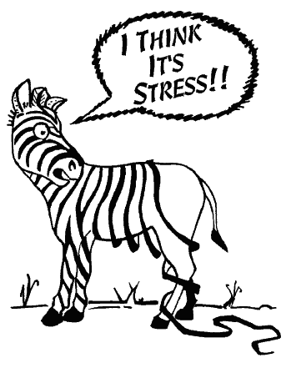
Effective Coping
See the humor in a stressful situation.

Slide 9
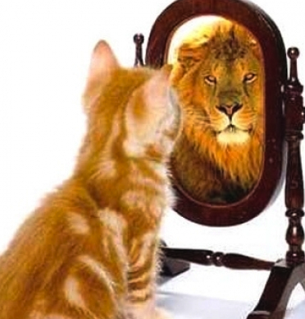
Effective Coping
Fake it till you make it. Pretend to have more confidence than you do. No one else will know the difference.

Slide 10
Effective Coping
Take care of yourself:
Eat nutrient-dense foods.
Exercise.
Avoid alcohol, tobacco, drugs.
Practice good hygiene.
Get adequate sleep.

Slide 11
Effective Coping
Rely on your support system:
Parents, family
Friends
Teachers
Counselors
Faith leader

Slide 12
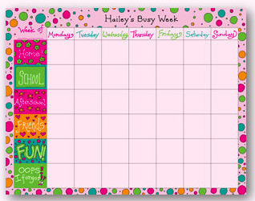
Effective Coping
Stick to your routine:
Keep a planner and “to do” list.
Take one step at a time.
Check off tasks as completed.

Slide 13
Effective Coping
Just Do It!
Take one step at a time and “git ‘er done!”

Slide 14
What NOT to Do to Cope with Anxiety

Slide 15
If Anxiety is Serious, Get Help!

Slide 16
Defense Mechanisms
Defense mechanisms are behaviors that an individual might use to cope with an uncomfortable situation or problem.

Slide 17
Compensation
A person tries to make up for his/ her weaknesses by developing strengths in other areas.
Example – A struggling student with a learning disability becomes a leader in the art club.
Harmful – Not trying to overcome the weakness.

Slide 18
Daydreaming
A person escapes unpleasant, boring, or frustrating situations by imagining that he or she is doing something else.
Example – A shy student imagines that he/she is homecoming king/queen.
Harmful – Refusal to accept reality and spending too much time in an imaginary world.

Slide 19
Denial
Refusal to accept reality.
Example – A student finds out that a relative has a terminal disease. The student continues to act as though the relative is going to live.
Harmful – Continual inability to accept a situation long after it has occurred.

Slide 20
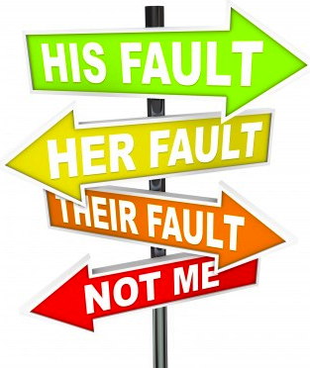
Displacement
A person transfers the emotions he or she feels from the original situation or object to another situation or object.
Example – A student is angry with a parent but yells at his/her brother or sister.
Harmful – Continuously taking anger out on an innocent person.

Slide 21
Humor
A person focuses on the funny aspects of a painful situation.
Example - A person is called a bad name and then refers to himself by that name to deflect the teasing.
Harmful – Person is accepting a social injustice. Name-calling should not be tolerated.

Slide 22
Identification
A person tries to assume the qualities of someone that is admired.
Example - A students wants to be like a famous person so they begin to dress and act like that person.
Harmful – Measuring own worth to someone else’s standards instead of developing one’s own strengths.

Slide 23
Projection
A person shifts the blame and/or responsibility for his/her actions or thoughts to another person.
Example – A student does poorly on a test and says that the teacher wrote an unfair test.
Harmful – Refusal to accept responsibility for actions.

Slide 24
Rationalization
An attempt to justify one’s actions with an excuse rather than by admitting one’s failure or mistake.
Example – A student justifies flunking a test because he/she was absent the day it was scheduled. [Or, the dog ate his homework!]
Harmful - Refusal to accept responsibility for actions.

Slide 25
Regression
Retreating to an earlier time that seems less threatening and requires less responsibility.
Example – A student has trouble fitting in at middle school so he/she returns and visits their elementary school, thinking that it would be nice to stay there.
Harmful – Refusal to move on and mature within a reasonable amount of time.

Slide 26
Repression
Blocking out thoughts about unpleasant things or experiences. Repression is actually an unconscious method of escaping something unpleasant.
Example – A woman is raped, she pushes the thought out of her mind, she doesn’t even think it happened.
Harmful – Inability to recognize what has happened, especially if she needs to receive help.

Slide 27
Sublimation
Transforming unacceptable behaviors into acceptable ones. Sublimation can involve redirecting specific behaviors.
Example – A student likes to get into arguments, so he/she decides to join the debate team.
Harmful – Inability to recognize the need to change unacceptable behaviors into acceptable ones.

Slide 28
Suppression
The effort to hide and control unacceptable thoughts and feelings.
Example – A student is attracted to someone, but he/she says that they do not like the person at all.
Harmful – Inability to let true feeling show.

