Slide 1
Working Together
for Environmental Health

Slide 2
The most effective way to reduce waste is to not create it in the first place.
By reducing and reusing, consumers and industry can save natural resources and reduce waste management costs.
Unfortunately, the amount of waste generated in the United States has been increasing.
Between 1960 and 2010 the amount of waste each person creates increased from 2.7 to 4.4 pounds per day.
This results in about 250 million tons of waste generated in the US in 2010.

Slide 3
Benefits of Reduction
• Saves natural resources (Natural resources: Resources supplied by nature such as land, minerals, water, etc.)
• Reduces toxicity of waste (Waste is less poisonous)
o Using less hazardous alternatives for certain items (e.g., cleaning products and pesticides), sharing products that contain hazardous chemicals instead of throwing out leftovers, reading label directions carefully, and using the smallest amount necessary are ways to reduce waste toxicity
• Reduces cost
o Communities: Some communities have a “pay as you throw” program—citizens pay for the items they throw away; if they throw away less, they pay less.
o Businesses: Business that use less packing use fewer natural resources, create less material to be thrown away.
o Consumers: Buy products in bulk, buy products with less packaging, and buy products that are reusable.

Slide 4
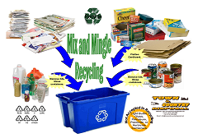
Recycling
Recycling is a series of activities that includes collecting recyclable materials that would otherwise be considered waste, sorting and processing these into raw materials such as fibers, and manufacturing raw materials into new products.

Slide 5
Step 1. Collection and Processing
Collecting recyclables varies from community to community, but there are four primary methods: curbside, drop-off centers, buy-back centers, and deposit/refund programs.
Recyclables are sent to a materials recovery facility to be sorted and prepared into a material that can then be made into other products.
How are recyclables collected in your community?
Step 2. Manufacturing
Once cleaned and separated, the recyclables are ready to undergo the second part of the recycling loop.
More and more of today's products are being manufactured with total or partial recycled content.
Common household items that contain recycled materials include newspapers and paper towels; aluminum, plastic, and glass soft drink containers; steel cans; and plastic laundry detergent bottles.
Recycled materials also are used in innovative applications such as recovered glass in roadway asphalt (glassphalt) or recovered plastic in carpeting, park benches, and pedestrian bridges.

Slide 6
Step 3. Purchasing Recycled Products
Purchasing recycled products completes the recycling loop.
By "buying recycled,” businesses and individual consumers, each play an important role in making the recycling process a success.
Recycling Facts & Figures
* Recently, recycling and composting activities prevented about 64 million tons of material from ending up in landfills and incinerators.
Today, this country recycles 28 percent of its waste.
That is almost double what it was 15 years ago.
* While recycling has grown in general, recycling of specific materials has grown even more drastically: 42 percent of all paper, 40 percent of all plastic soft drink bottles, 55 percent of all aluminum beer and soft drink cans, 57 percent of all steel packaging, and 52 percent of all major appliances are now recycled.

Slide 7
Sticks in a bundle are unbreakable. (African Proverb)

Slide 8
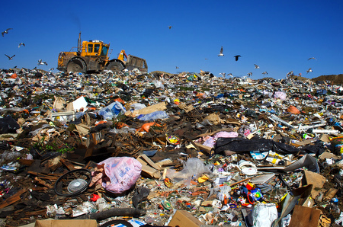
Recycling . . . Does it help?

Slide 9
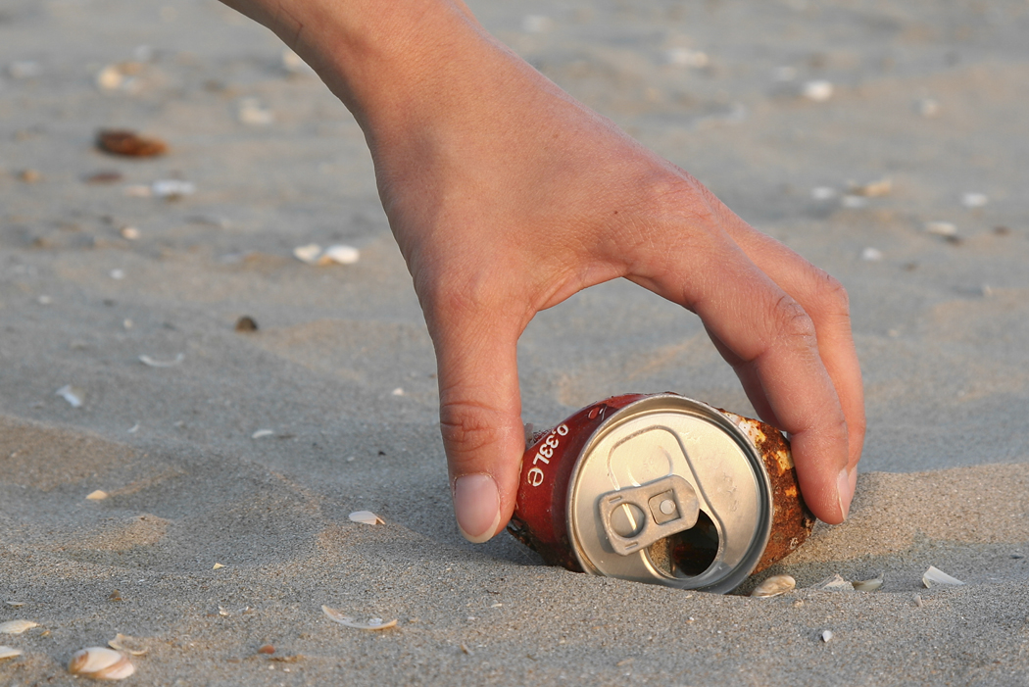
“Every little bit helps” is TRUE!

Slide 10
What can we do?

Slide 11
Cooperative Learning Activity
Number off by threes
Move to your group
Read about the assigned topic: reduce, reuse, or recycle
Take notes on the items listed on the next slide

Slide 12
Take notes on these topics . . .
Define your topic
List three strategies to reduce, reuse, or recycle
What are two “hints for parents?”
What would be your first step to begin to reduce, reuse, or recycle?

Slide 13
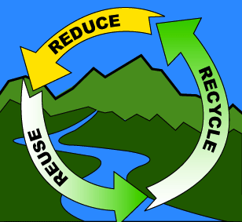
Peer Teaching . . .
Reconfigure into new groups
Teach your new group members about your topic

Slide 14
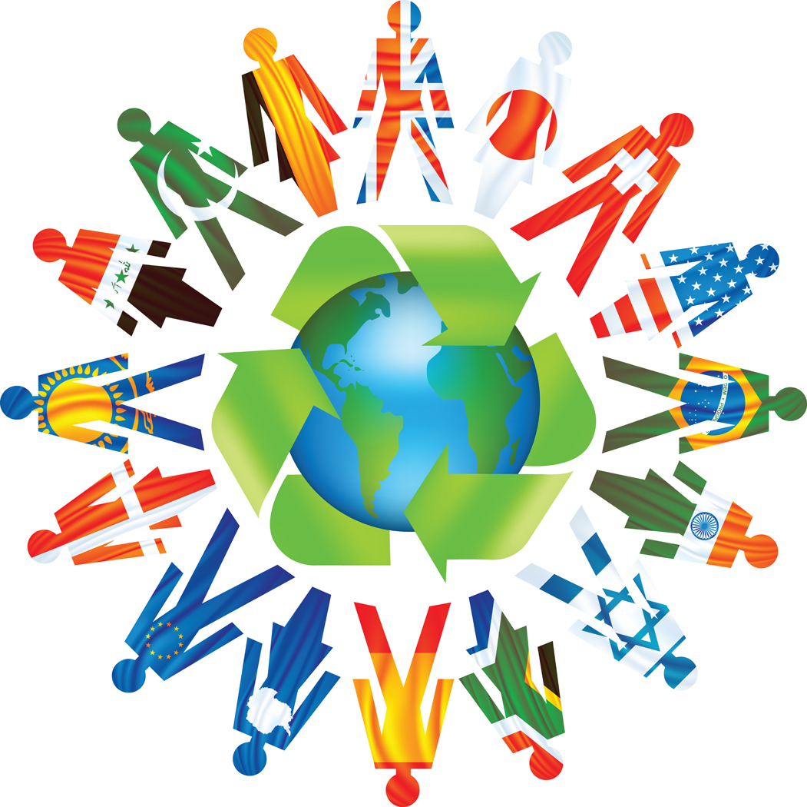
How do the 3 “RE”s show REspect for the earth and humanity?

Slide 15
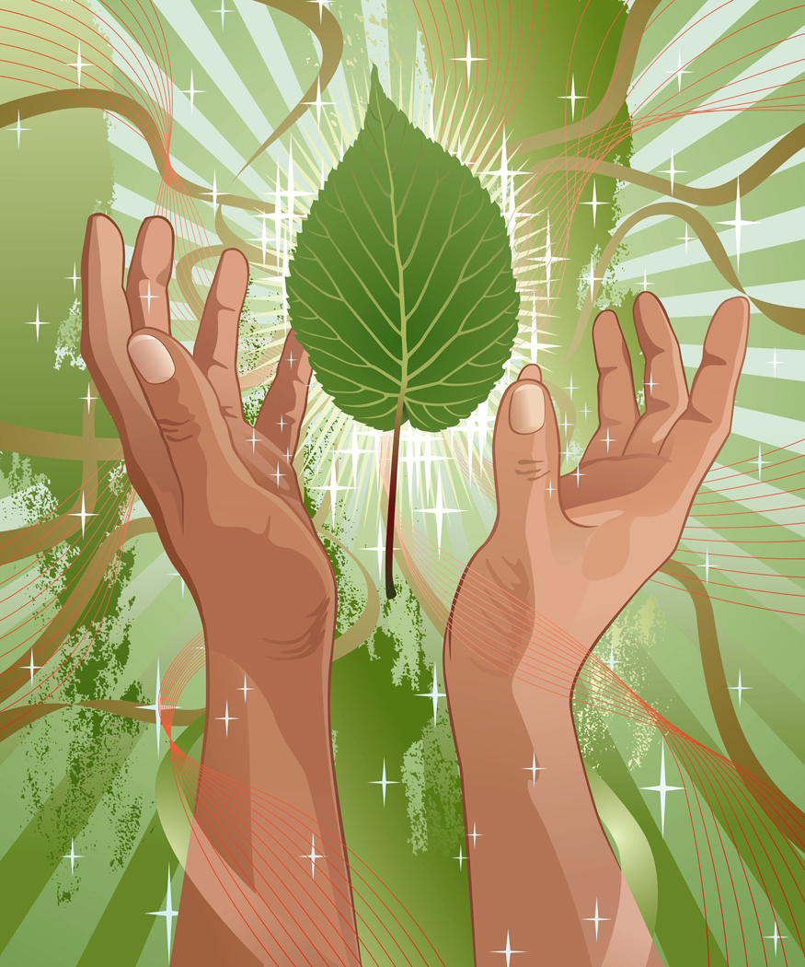
Real World Collaboration:
Return to your original groups
Brainstorm ways to reduce, reuse, and recycle on the school campus
Select 5 ways to put words into action
Plan the first 2 steps to implement the 3 “RE”s

