Slide 1
Asthma Facts
6th
Grade

Slide 2
Asthma
Asthma is a chronic lung disease that can be life threatening. The exact cause is unknown. However, once an individual has asthma, his or her lungs will respond differently to triggers than ever before.

Slide 3
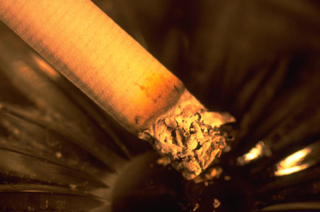
Asthma Triggers
What triggers an asthma attack varies from person to person. Some common triggers are:
Secondhand smoke
Dust mites
Pets
Mold
Pests

Slide 4
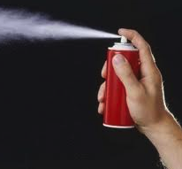
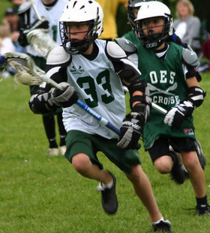
Asthma Triggers
Viral or sinus infections
Emotional anxiety
Medication
Food
Exercise
Gasses or fumes
Changing
weather conditions

Slide 5
Asthma Triggers
When someone who has asthma is exposed to a trigger, an asthma attack can develop rapidly, within minutes or slowly, over a period of a few days.

Slide 6
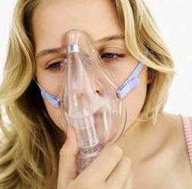
During an Asthma Attack:
The cells in the air tubes make more mucus than normal. This mucus is very thick and sticky. It tends to clog up the tubes.
The air tubes tend to swell, just as skin swells if it is cut or scraped.
The muscles in the air tubes tighten.
These changes cause the air tubes to narrow making it very difficult to breathe.

Slide 7
Signs of Asthma
Coughing - can be weak or vigorous
Wheezing - a whistling or musical sound heard when exhaling
Night time coughing
Difficulty in breathing
Flared nostrils

Slide 8
Subtle Signs of an Asthma Attack
Breathing changes
Feeling tired or weak
Funny feeling in the chest
Headache
Glassy eyes
Dark circles under eyes
Getting excited
Paleness
Watery eyes

Slide 9
Subtle Signs of an Asthma Attack
Sweatiness
Getting out of breath
Restlessness
Chin or throat itching
Becoming unusually quiet
Heart rate increases
Coughing
Sneezing
Dry mouth
Stuffy nose

Slide 10
Signs of a Severe Attack
Difficulty finishing a sentence
Severe coughing/wheezing
Flared nostrils
Head bobbing
Grayish blue tint around fingers and lips
Wheezing that stops even though other symptoms are still present

