Slide 1
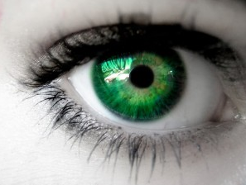
Eyes and Vision

Slide 2
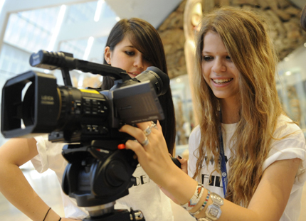
Review: List ways vision helps us

Slide 3
Brainstorming: Eye Risks and Protection
Risks:
Exposure to the sun
(continue list)
Protection:
Safety goggles
(continue list)

Slide 4
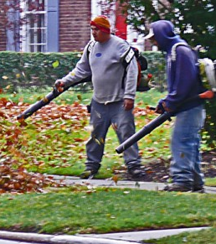
Risks to Eyesight
Diabetes
Operating machinery
Exposure to the sun
Water sports
Skiing

Slide 5
Risks to Eyesight (continued)
Outdoor activities
Power equipment
Secondhand smoke
Over exposure to monitors, TV

Slide 6
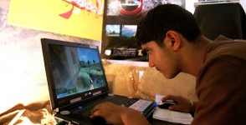
Risks to Eyesight (continued)
Looking at photocopier lights
Computer gaming
Environmental mold
Allergies

Slide 7
Protection of Vision
Low-sugar diet
Exercise
Safety goggles
Sunglasses that protect
against UV radiation
Wear a hat, wide brim

Slide 8
Protection of Vision (continued)
Ski goggles
Swimming goggles
Eye exercises; look up down, side to side, and all around
Eating vegetables
Getting adequate sleep

Slide 9
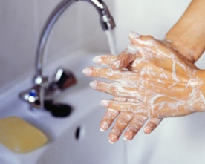
Protection of Vision (continued)
Vitamin A
Taking breaks from computer
Keeping fingers out of one’s
eyes to prevent infection
Washing hands regularly

Slide 10
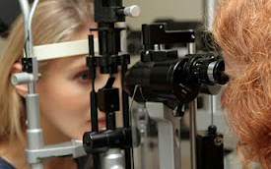
Protection of Vision (continued)
Eye drops for dry eyes
Regular eye check-ups
Good posture
Computer screen at eye level
Clean environment

Slide 11
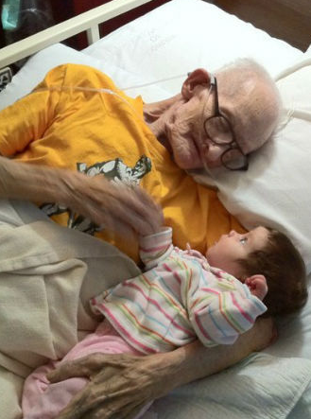
We need healthy vision throughout our lives.

