Slide 1
Predicting and Avoiding Conflict & Nonviolent Conflict Resolution

Slide 2
Which of the following are potential sources of conflict?
Common Traits
Aggressive Tone
Alcohol Use
Empathy
Disrespectful Language
Effective Listening
Poor Communication
Differences of Opinion
Competition for Limited Resources
Similar Opinions

Slide 3
Conflict…
can often be avoided but is sometimes inevitable.

Slide 4
VIOLENCE…
is often a result of conflict that was not avoided or poorly managed.

Slide 5
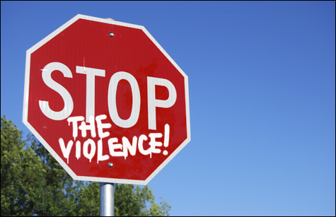
Violence is a learned behavior and can be prevented.

Slide 6
Violence Can Cause:
Physical Injuries
Emotional Trauma
Social Challenges (academic difficulties and loss of productivity in the workplace)
Mental Health Problems (anxiety, depression, post-traumatic stress disorder)

Slide 7
Violence Among Young People in the US
2nd leading cause of death for young people between the ages of 10-24 in 2010.
Over 656,000 physical assault injuries in young people between ages of 10-24 were treated in US emergency rooms in 2008.
7.4% of high school students received a threat or were injured with a weapon on school property one or more times during the last 12 months in 2011.
32.8% of high school students indicate they were in physical fight one or more times during the last 12 months in 2011.
Source – www.cdc.gov

Slide 8
5,764 young people ages 10-24 were murdered in 2007.
16
An average of 16 each day

Slide 9
Think of one incident…
Silently think of one argument or disagreement that you have experienced.
Were there any signs that a conflict was beginning? If so, what were these signs?
If you had recognized these signs and acted to avoid the conflict would the situation have ended differently?

Slide 10
Conflict Avoidance
Does not mean ignoring a problem when conflict arises or pretending conflict does not exist.

Slide 11
Avoiding Conflict
If you can predict conflict, you can often avoid unnecessary arguments.
Avoid known triggers of conflicts with others.

Slide 12
Conflict Avoidance Strategies
Change the subject or walk away if a conflict is building but is unnecessary.
Avoid placing yourself in a situation (e.g., with certain people or at a particular location) known to create conflict.
Carefully and respectfully construct your expression of thoughts and opinions to avoid offending others, making them feel threatened, or placed in a defensive position.

Slide 13
Tips for Conflict Resolution
When you feel angry, walk away from the situation and take time to plan a thoughtful, rationale, and respectful response.

Slide 14
Tips for Conflict Resolution
Address the conflict or problem, don’t insult or disrespect the other person involved.
Use assertive not aggressive communication skills.

Slide 15
Tips for Conflict Resolution
Accept that others may have different opinions or beliefs.
Accept that resolution does not mean that one has to win or lose, work toward a solution where all can have some needs met.

Slide 16
Strategies for Resolving Conflict
Allow an opportunity for each person to share his/her perceptions and feelings and what he/she wants or needs to resolve the conflict.

Slide 17
Strategies for Resolving Conflict
LISTEN - Listen to learn and understand the perspective of others. Listen to the words and understand the complete message they are sending. Ask clarifying questions to make sure you understand what they are saying.

Slide 18
Strategies for Resolving Conflict
Encourage participation from all involved in the conflict and limit the discussion to ONLY those directly involved in the conflict, unless a teacher, parent, or impartial adult is needed.

Slide 19
Strategies for Resolving Conflict
Avoid blaming or attacking others.
Use “I-statements” to share personal opinions or thoughts.
Use “I” to describe how you feel or share your concerns.
Refer to the behavior not the person.
State how the behavior affects you.
State what needs to happen.

Slide 20
Strategies for Resolving Conflict
Work collaboratively to negotiate
next steps and resolutions.

Slide 21
Strategies for Resolving Conflict
Establish a date or opportunity in the future to revisit the situation to assure the resolution is fair and allow for re-negotiation if needed.

