Slide 1
Effects of Drugs

Slide 2
Alcohol
Alcohol is a depressant that decreases the function of the Central Nervous System.
Alcohol can impair coordination, memory, judgment, and decision making
Alcohol is both physically and psychologically addictive.
Notes:
Two key elements to piece together to students are lack of judgment and lack of coordination/motor function. Be sure to emphasize how alcohol can cause these two variables to lead unintentional injuries. In particular: drunk driving.
Also, be able to explain to the class the difference between physical and psychological addiction. Physical addiction means that the human can develop a dependence for the drug. If one is highly addicted to alcohol, the person may feel the need to consume alcohol in order to function in daily activities.
Psychological addiction involves no physical substance. One could be addicted to gambling, shopping etc. Though alcohol has physical addicting substances in it, one could still be addicted on a psychological level.

Slide 3
Risks and Effects
Short-Term
Long-Term
Reduced tension
Poor concentration
Reduced coordination
Slurred speech
Altered emotions
Vomiting
Possible death
Disrupts brain development
Liver damage
Risk of heart disease
Brain cells die
Unintentional injuries
Family problems
Notes:
Make sure to note that the short term risks range from small doses to heavy doses. It is important to address to the the class that 4-5 drinks at one time is considered binge drinking. Also, state that alcohol consumed by minors is in the form of binge drinking 90% of the time!
For Long term effects, illustrate how there are not only physical effects, but psychological effects. Ask the class if they can think of examples for unintentional injuries and family problems. Why long term use of alcoholism produce these types of problems?

Slide 4
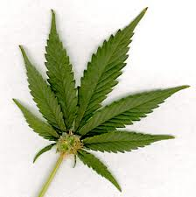
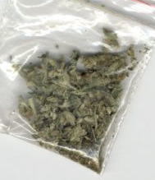
Marijuana
Marijuana consists of dried and shredded leaves, seeds, stems and flowers from the plant cannabis sativa.
Marijuana is mainly regarded as a hallucinogenic drug.
Marijuana is a highly psychologically addictive drug.
Notes:
Once again, be sure to emphasize how a psychological addiction would be something like shopping or gambling. A person cannot develop a physical dependence for marijuana, although marijuana smoking can be a difficult habit to break.

Slide 5
Risks and Effects
Short-Term
Long-Term
Distorted perception
Loss of coordination
Trouble with thinking and problem solving
Paranoia and anxiety
Short-term memory loss
Damage to lungs
Fatal accidents
Depression
Anxiety
Notes:
Emphasize that marijuana smoke contains 50% to 70% more carcinogenic hydrocarbons than tobacco smoke. Also, emphasize that long term marijuana use can hinder brain development at a young age. Ask the class if they can think of ways in which marijuana use can potentially reduce ones chances of achieving their long term goals.

Slide 6
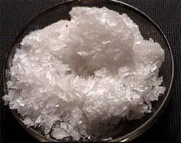
Methamphetamine
Meth is a highly addictive stimulant that releases the brain chemical dopamine.
Meth is a very dangerous drug to make, as it contains many chemicals that are harmful to the body.
Meth can be snorted, smoked, or injected into the bloodstream.

Slide 7
Risks and Effects
Short-Term
Long-Term
Increased wakefulness
Decreased appetite
Irregular heartbeat
Increased blood pressure
Anxious and violent behavior
Tremors
Scabs and open sores
Loss of weight
Prolonged insomnia
Notes:
Emphasize that meth is an extreme stimulant. Methamphetamine makes one feel like they are on the best high of their life, but when their dopamine levels crash, they are left feeling anxious and empty. Meth is very dangerous in that it is made with chemicals, it is cheap, and it is highly addicting. Taking Meth just once can lead to severe addiction!

Slide 8
Meth: Not Even Once
http://www.youtube.com/watch?v=LkLiwPhdUJU
Notes:
Once this video is finished playing. Discuss with the class how meth is one of the most addictive drugs out there. Encourage the class to examine their family relationships and their long-term goals. Ask the class to list ways in which meth and other drugs would interfere with these long-term goals and relationships.

