Slide 1
8.MEH.1.1 Evaluate stress management strategies based on personal experience.

Slide 2
Objectives
The student will identify a variety of techniques for managing personal stress.
The student will describe the importance of self-reflection in evaluating his or her most effective stress-management strategies.
The student will apply effective methods for coping with stress based on personal experience.

Slide 3
Positive stress management techniques
Brainstorm a list of health stress management techniques your are familiar with
talking it out
journaling
exercise
progressive
muscular
deep
breathing
time management
meditation

Slide 4

Self reflection
Careful thought about your own behavior and beliefs.
~(Merriam-Webster dictionary)

Slide 5
Self reflection & stress management
How are self reflection and effective stress management related?
What are some examples of times when self reflection resulted in making a healthy choice?
Notes:
Both are associated with several skills (goal decision, decision making, behavior self management) and can positively influence one’s mental health.

Slide 6
Steps for self reflection
How do I feel? How did I feel earlier in the day, yesterday or the week before?
• Why do I feel this way?
• Why did I act in a certain way? What prompted me to act like that?
What does this tell me about myself? What can I learn from this situation?
If I am in this situation again, what would I do the same and what would I do differently?

Slide 7
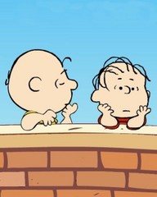
Final thoughts…
Linus: “I guess it is wrong to be worried about tomorrow, maybe we should only worry about today?”
Charlie Brown: “No, that's giving up: I'm hoping that yesterday will get better!”
Credit: Charles Schultz, Peanuts

Slide 8

Stress-provoking Scenarios
Review Step
8.MEH.1.1Evaluate stress management strategies based on personal experience.

Slide 9

Instructions
Read the following scenarios.
Decide if the teens’ response is appropriate for the situation or inappropriate.
If it is not useful, why not?

Slide 10

Scenario 1
Tom worked very hard on a project for school. Danny waited until the last minute to do his project and then asked to copy from Tom. Danny implied that if Tom did not let him copy, Danny would no longer be his friend. Tom decides to allow Danny to copy his work.

Slide 11

Scenario 2
Farah's teacher gave the class unclear directions about a project. Farah worked harder than most of her classmates on her project, only to find that she had done the project all wrong.
Farah approaches her teacher and explains her confusion and asks for an opportunity to re-do the assignment.

Slide 12
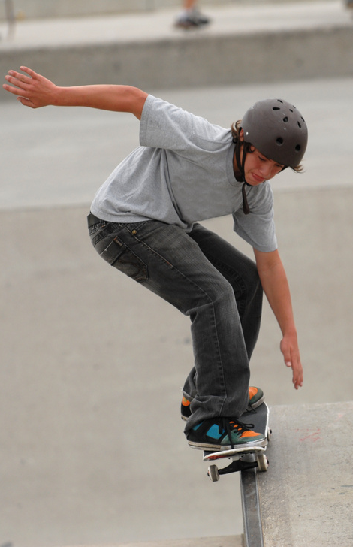
Scenario 3
Mike has grown up in the southern part of the United States. Recently, he moved to the northern part of the country. Some students make fun of the way Mike talks. Mike decides to tell students that they sound different to him, as well, but he bets they have more in common than they might think. He asks if anyone wants to go to the skate park after school.

Slide 13

Scenario 4
Molly's parents are getting divorced and she feels overwhelmed and unable to think. She knows that her mom has some medicine in the bathroom that she sometimes takes for her “nerves”. Molly decides to take one to help her anxiety.

Slide 14

Scenario 5
Sally invites Ann to go shopping. When they get to the store, Sally finds she has enough money to buy clothes, but not enough to buy a pair of earrings she wants. She asks Ann to slip the earrings in her pocket while she pays for the clothes. Ann thinks stealing is wrong, but she really wants to be friends with Sally. Ann drops the earrings in her backpack and walks out of the store.

Slide 15

Scenario 6
Owen feels overwhelmed with all of the stuff he needs to everyday. He loves to play his guitar, he likes school (especially his Visual Arts class)and wants to do well. He also enjoys playing sports and walking dogs at the local animal shelter. Owen decides to create a “Things To Do Today/Week List” to help prioritize all of his activities.

Slide 16

Scenario 7
Kim is preparing to give a speech tomorrow. She is nervous and fidgety and is afraid she won't be able to sleep. She decides to ask her mom if she can practice on her when she is finished writing her speech, then do the progressive muscular exercises she was taught in school.

Slide 17

Scenario 8
Allen believes a friend of his is depressed, maybe even thinking about suicide. Allen decides to tell his friend that he is worried about her and persuades her to speak with their teacher.

Slide 18
Time management
8.MEH.1.2 Design a plan to prevent stressors or manage the effects of stress.

Slide 19

Focus Step Quote
"The bad news is time flies. The good news is you're the pilot."
Michael Altshuler

Slide 20
Time Management
Time management refers to a range of skills, tools, and techniques used to manage time when accomplishing specific tasks, projects and goals.
or...
What will I do and how will I do it?

Slide 21
Why learn time management?
Poor time management = stress
Common Road blocks:
  The idea that time is adjustable rather than fixed
  Idea that time management techniques don’t work
  Crisis management rather than time management (“But I work better under pressure.”)

Slide 22
Think, Pair, Share
How is decision-making relevant to time management?
Why is time management necessary for reaching your short-term goals?
Why are short-term goals necessary for reaching your long-term goals?

Slide 23
Time Management Techniques
Prioritization
Time Mapping

Slide 24
Prioritization: A, B, C Rank Order
Brainstorm a “To Do” list of everything you need to accomplish in one week (or month, or year). depending upon short- or long-term goals
Assign an A to all of the things that must get done as soon as possible.
Assign a C to all of the things you would like to do but are not essential.
Assign a B to everything else.
Rewrite your “To Do” List in the new order (A items, B items, C items), then complete these tasks in that order.

Slide 25
Time Mapping
Make a “To Do” list of all things you need to complete in a week, and all things you would like to complete in a week.
Assign a color to common tasks, for example:
  Blue = time in school
  Orange = school work
  Green = afterschool activities
  Yellow = work
  Purple = family time
Using a weekly calendar with hour segments of time, list the activity that needs to be completed in the block(s) and color-code each activity.
Monday | Tuesday | Wednesday

Slide 26
Time Sinks
The things that take up more time than you anticipate and get you behind schedule
What are some common “Time Sinks” that you deal with?
Hint: this might be one!

Slide 27
Final thought:
Turn elephants into hors d’oeuvres.
Take a huge task and turn it into smaller chunks.

